Slide 1
Information Retrieval: Lexical Retrieval & Classical Sparse Indices
Introduction to Deep Learning: Class 4.2

Slide 2
Module Agenda
IR problem setup and evaluation
Lexical Retrieval and Classic Sparse Indices
Set/String Similarity
Minhash
LSH
Semantic Similarity and Dense Retrieval
Indexing for Fast ANN
HNSW, IVF, PQ
Sparse Neural Retrieval
Splade, Hybrid search
Rank fusion and re-ranking

Slide 3
Pre-read
CS276: Scoring, term weighting and the vector space model

Slide 4
Lexical Retrieval & Classical Sparse Indices
High-level goals
Explain how text is turned into terms (tokenization, normalization).
How important is each term: term frequency, document frequency, TF-IDF.
How to quickly find relevant documents for a term: inverted index.
Understand and compute BM25 scores on a toy example.
Explain what n-grams are and why they’re used.

Slide 5
From documents to tokens..
“Best hikes near San Francisco.” -> [“Best”, “hikes”, “near”, “San”, “Francisco.”]
Normalization: Map different surface form to the same term, remove punctuations
“Best hikes near San Francisco.” -> [“best”, “hikes”, “near”, “san”, “francisco”]
Stop word removal: remove common, low information words.. “and”, “but”, “if”..
Stemming: Heuristics to chop word endings. “running” -> “run”
Lemmatization: Map to base form. “mice” -> “mouse”
Tokenization pipeline:
Convert to lower case -> remove stop words -> remove punctuation -> split on white space

Slide 6
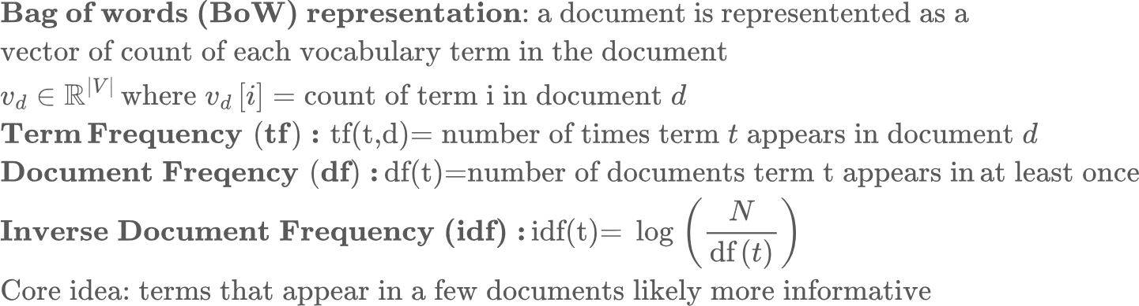
Bag-of-words and term statistics
d1: "Best hikes near San Francisco bay area" d2: "Hiking safety tips and trail etiquette" d3: "Top restaurants in San Francisco"
While matching a query to a document corpus, I could just look at the query and docs as a bag of words (ignoring order), and calculate overlap.. But this gives the same importance to every word. Not ideal.
Need a concept that captures word importance.
Vocabulary: Set of all unique tokens (terms) in the document corpus: {“best”, “hikes”, “near”, “san”, “francisco”, “bay”, “trail”..}
Example: df(best) = 1, df(san) = 2, df(restaurants) = 1..

Slide 7
Inverted Index
d1: "Best hikes near San Francisco bay area" d2: "Hiking safety tips and trail etiquette" d3: "Top restaurants in San Francisco"
Core idea: Maintaining a vocabulary sized vector for each document is inefficient. Instead, maintain an inverted index, term -> list of doc ids that contain those terms
Eg.,
“hikes” -> {d1}
“san” -> {d1, d3}
“hiking” -> {d2}
“francisco” -> {d1, d3}
Then processing a query: “San” AND “Francisco” becomes a set operation
“San” AND “Francisco”: San: {d1, d3} intersection Francisco: {d1, d3} = {d1, d3}
“hikes” OR “Francisco”: hikes {d1} union Francisco: {d1, d3} = {d1, d3}
AND -> Intersection, OR -> Union..

Slide 8
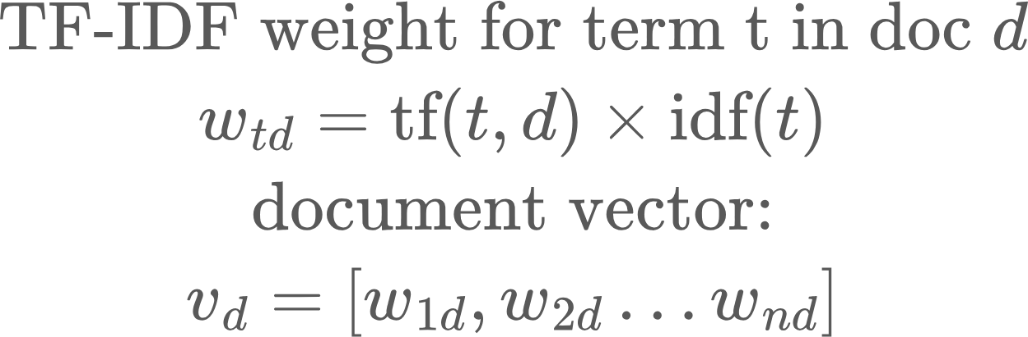
TF-IDF weighting
Not all terms in a doc/query are equally important..
Calculate TF-IDF weight for each term in each doc and represent a doc by a vector of weights. Do the same for the query, then rank docs by dot product

Slide 9
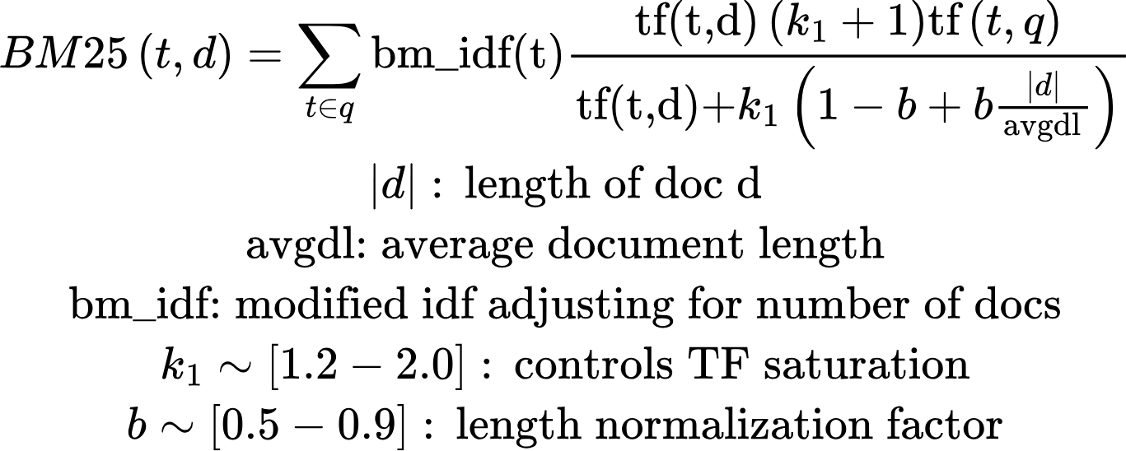
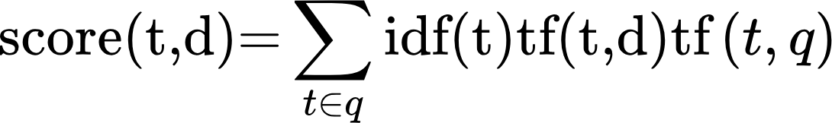
BM25: Better Lexical Ranking Function
Limitations of TF-IDF:
Long docs can have high scores, just by having more words (higher tf)
For a term, going from 1 to 2 matters, but from 41 to 42 not so much..
BM25 score of a doc d for terms t in a query:
vs

Slide 10
N-grams and phrase queries
Sometimes single-word tokens are insufficient.
“New York” as a bi-gram means something different from “New”, “York”
Same with “machine learning”
Word n-grams: sequence of n consecutive words
Eg., for “best hikes near San Francisco”
Bigrams: [“best hikes”, “hikes near”, “near San”, “San Francisco”, “hikes near”...]
Trigrams: [“best hikes near”, “hikes near San”...]
Character n-gram: sequence of n consecutive characters
“hikes” -> trigrams: [“hik”, “ike”, “kes”]
Indexing with n-grams:
Build inverted index over n-grams
Pre-compute frequent phrases as tokens

Slide 11
HW
Coding problem: hw_lexical_ir.py

